Slide 1

Analysis Of Demand And Supply Of A FMCG Noodles Company For Optimum Product Weight Delivery.
Analysis by Orhine Adidi

Slide 2
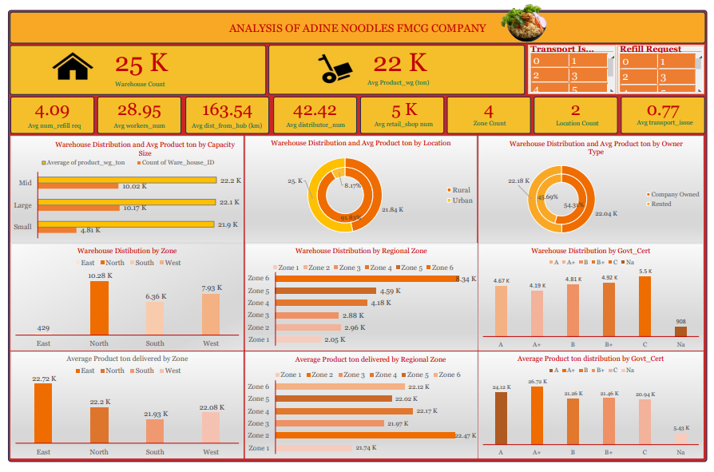

Slide 3
Table of Contents
Introduction
Business Problem
Aim/Objectives
Data Source/Preparation
Methodology
Key Findings/Insights (Exploratory Data Analysis )
Statistical Analysis
Conclusion
Recommendations

Slide 4
01
Introduction
Adine Noodles is a fast-growing FMCG company in the instant noodles company with over two years experience in Noodle supply spread over various states in Africa is seeking to understand their data better due to rising competitions in the market, lapses in revenue and profit, location sale issues. They hired The A Company to perform an analysis on their data to dive into the data and bring out useful information and recommendation to help them stay in the market and grow in the industry.

Slide 5
Business Problem
Adine Noodles (A FMCG company) has entered into the instant noodles business two years back. Their higher management has notices that there is a miss match in the demand and supply. Where the demand is high, supply is pretty low and where the demand is low, supply is pretty high. In both the ways it is an inventory cost loss to the company; hence, the higher management wants to optimize the supply quantity in each and every warehouse in entire country.

Slide 6
Aim / Objectives
Aim
Objectives
The main aim of this analysis is to build a model, using historical data that will determine an optimum weight of the product to be shipped each time to the warehouse.
Analyze the demand pattern in different pockets of the country.
How much product is supplied vs demanded per warehouse/region/zones?
Analyze warehouse issues (transport, breakdowns, electricity, floods etc.)
Recommendations to drive advertisement campaigns in country pockets.

Slide 7
Data Source
The dataset used for this analysis was obtained from Kaggle (https://www.kaggle.com/datasets/suraj9727/supply-chain-optimization-for-a-fmcg-company) and contains 25,000 sales records for 2 years (years not specified).

Slide 8
Data Preparation / Cleaning
Dataset initially had 24 columns by 25,000 rows. Cleaning involved;
Removing duplicate records.
Converting all numerical columns to numeric values.
Missing values replacement: I replaced the missing values on the workers_num column with average of the column, the volume of missing data there wasn’t much – hence that was the best option as it couldn’t be gotten from the source.
Feature Engineering: I created new columns to convert 0s and 1s to No and Yes on the flood and electric issue columns.
Trimming for white spaces.
Formatting of text columns in terms of letter casing and
Spell checking.

Slide 9
Methodology
Analysis was conducted using Microsoft Excel. Pivot tables were used to summarize warehouse distribution and average product ton delivered by zone, location, regional zone, capacity size, owner type and government certificate. Descriptive statistics such average were calculated on overall average product ton, average num_refill_req, average workers_num, average dist_from_hub, average retail_shop_num, average transport issue. Correlations were also analyzed to evaluate the relationship between all major variables and product ton delivered.

Slide 10
Key Findings / Insights
Fig 1 shows the warehouse distribution across different warehouse sizes in the country. It can be observed that although the number of type of warehouses differ, in terms of average product (in ton) delivered, there are all approximately the same.

Slide 11
Key Findings / Insights
Fig 2 shows the warehouse distribution across Rural and Urban locations in the country. Although they are more warehouses in the Rural area (91.83%) of the country, on average more products get delivered to the Urban area (25K) than Rural areas.

Slide 12
Key Findings / Insights
Fig 3 shows the warehouse distribution by Regional Zone. We can see that the North zone has more warehouses. Before now we also saw that most warehouses are in Rural areas, going deeper we see that overall, regardless of zone the countries warehouses are situated in the Rural areas of these zones.

Slide 13
Key Findings / Insights
Fig 4 shows us that more East zone has the highest average product weight delivered. Relating this to the number of warehouses per zone, where we observed that East zone has fewer warehouses, this signifies that number of warehouses don’t determine the average weight of products being delivered to that zone, but rather the capacity size of those warehouses.

Slide 14
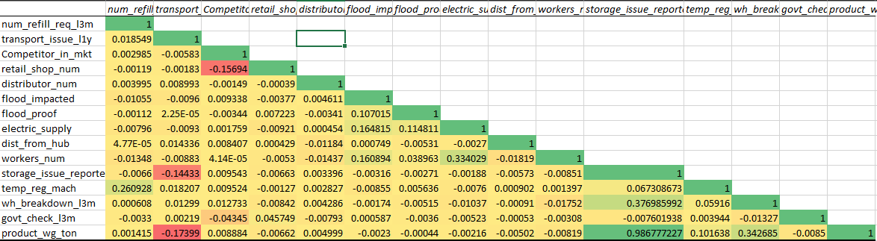
Statistical Analysis - Correlation
Four operational variables significantly influence product weight delivered:
1. Transport Issues
2. Storage Issues
3. Temperature-Regulated Machinery
4. Warehouse Breakdowns

Slide 15
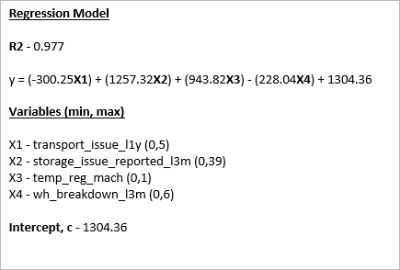
Statistical Analysis - Regression
This image shows the regression model gotten from the regression summary, the placing of the coefficient of each variable into the model.
With an R² of 0.97, the model explains 97% of the variability in delivery weight and is suitable for operational forecasting and decision-making.

Slide 16
y = (-300.25X₁) + (1257.32X₂) + (943.82X₃) - (228.04X₄) + 1304.36
Regression Model
Where:
X₁ = Transport Issues
X₂ = Storage Issues
X₃ = Temperature-Regulated Machines
X₄ = Warehouse Breakdowns

Slide 17
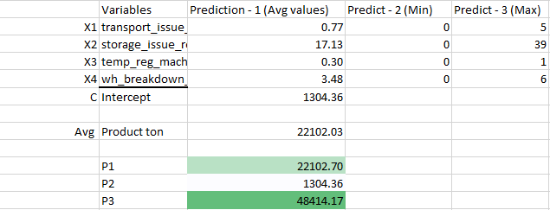
Model Results
P1 (Prediction 1) was gotten using the average value of each variable to predict the product weight.
P2 (Prediction 2) was gotten using the minimum value of each variable. For this model, the minimum value of the variables are all 0, hence the predicted product ton is equal to the intercept of the model.
P3 (Prediction 3) was gotten using the maximum value of each variable.

Slide 18
Conclusions
In conclusion, from the correlation heatmap and from the predictive model, we see that the only variables that have a significant impact on product weight to be delivered are:
1. Number of transport issues reported – which for every increase in transport issues, the product weight delivered is reduced.
2. Number of storage issues reported – which for every increase in storage issues, the product weight delivered is increased. Possible meaning that when storage issues are reported, instead of more products (Quantity) to be delivered, only heavier shipments are delivered.
3. Temperature regulated machineries – which for every increase, the product weight delivered is increased. Possible meaning that, the more warehouses have temperature regulated machines, the more products get delivered there – possibly more frozen goods.

Slide 19
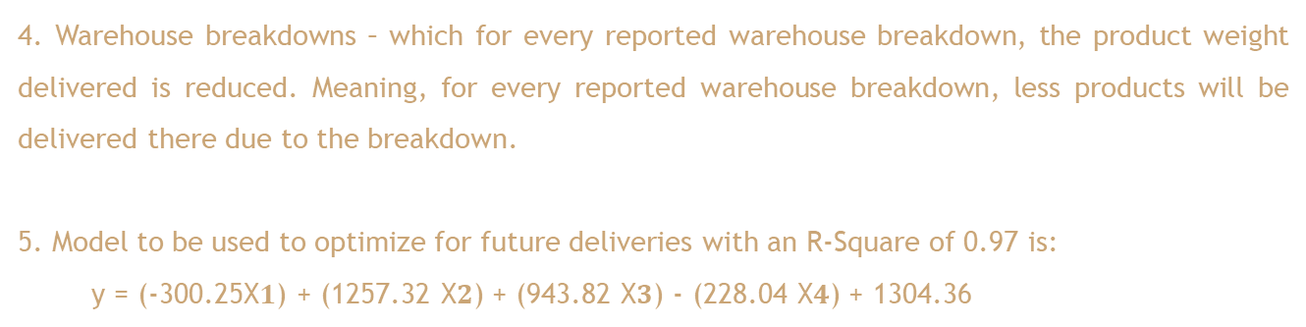
Conclusion
4. Warehouse breakdowns – which for every reported warehouse breakdown, the product weight delivered is reduced. Meaning, for every reported warehouse breakdown, less products will be delivered there due to the breakdown.
5. Model to be used to optimize for future deliveries with an R-Square of 0.97 is:
y = (-300.25X$1$) + (1257.32 X$2$) + (943.82 X$3$) - (228.04 X$4$) + 1304.36

Slide 20
Recommendations
To optimize performance and profitability, management should prioritize:
Reducing transport disruptions through preventive fleet maintenance and route optimization.
Investigating and correcting root causes of storage issues, especially overstocking and inventory mismanagement.
Strategically expanding temperature-regulated infrastructure in high-demand or high-capacity zones.
Improving warehouse reliability through preventive maintenance and backup systems.
Integrating the predictive model into planning dashboards for scenario simulation, weekly forecasting, and operational target setting.

Slide 21

Thank You!
Contact Orhine Adidi to Analyze your data
adidiorhine16@gmail.com

